Slide 1

Recent Experimental Results from RHIC spin and Belle FFs
Anselm Vossen
CEEM
QCD Evolution 2012
JLab

Slide 2

Selection of Topics
PHENIX and STAR detectors at RHIC
  Highlights of the longitudinal program
  Forward transverse spin asymmetries for pi0, eta
  Correlation measurements with transverse spin: Collins and di-hadron measurements to access transversity
Belle
  Transverse spin dependent di-hadron Interference FFs
  Unpolarized Fragmentation Functions

Slide 3
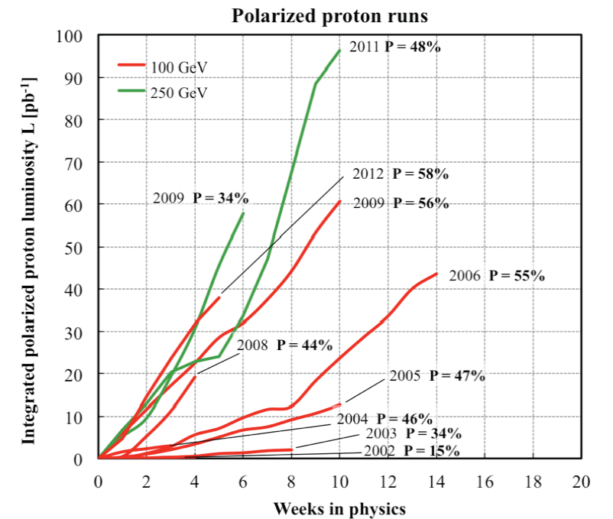
The RHIC Polarized Collider
Absolute Polarimeter (H↑ jet)
RHIC pC Polarimeters
E-Lens and Spin Flipper
A_{N}DY/ BRAHMS
Siberian Snakes
Siberian Snakes
PHENIX
STAR
Spin Rotators
(longitudinal polarization)
Spin Rotators
(longitudinal polarization)
Pol. H⁻ Source
LINAC
EBIS
BOOSTER
Helical Partial Siberian Snake
200 MeV Polarimeter
AGS
AGS pC Polarimeter
Strong AGS Snake
Versatility:
Polarized p+p Sqrt(s) collisions at 62.4 GeV, 200 GeV and 500 GeV
Recent Spin Runs:
2011 500 GeV, longitudinal at Phenix, transverse at STAR ~30 pb^-1 sampled
2012 200 GeV, Phenix and STAR, transverse ~20 pb^-1 sampled (at STAR: ~x10 statistics)

Slide 4
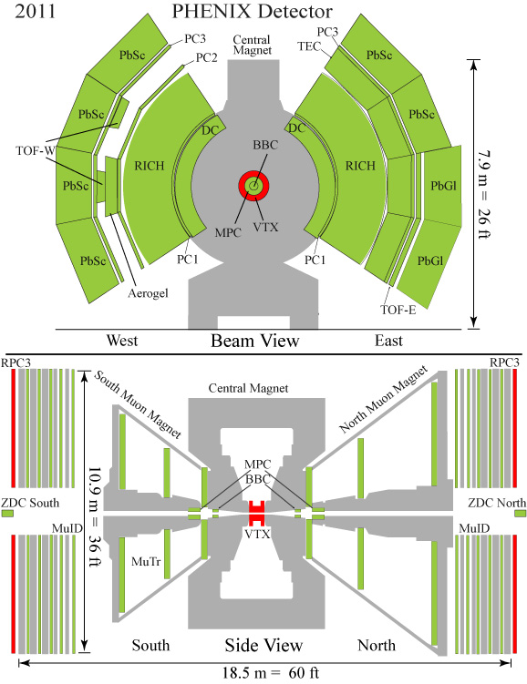
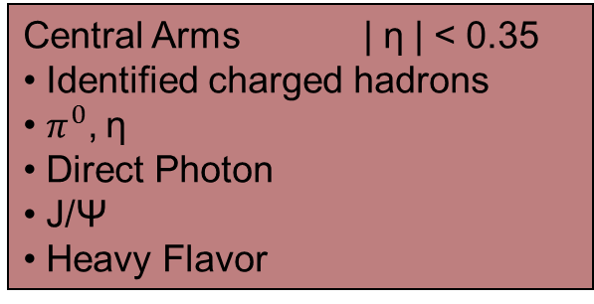
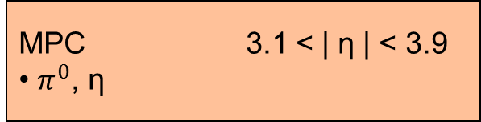
PHENIX Detector at RHIC

Slide 5

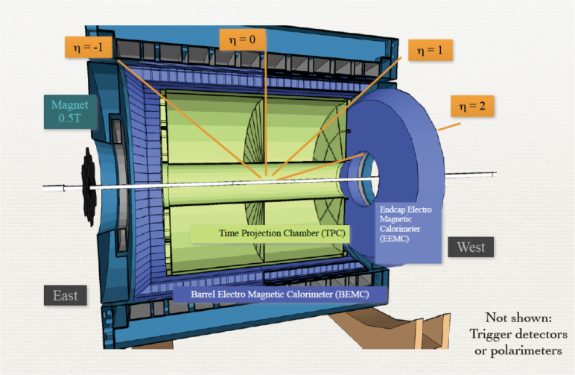
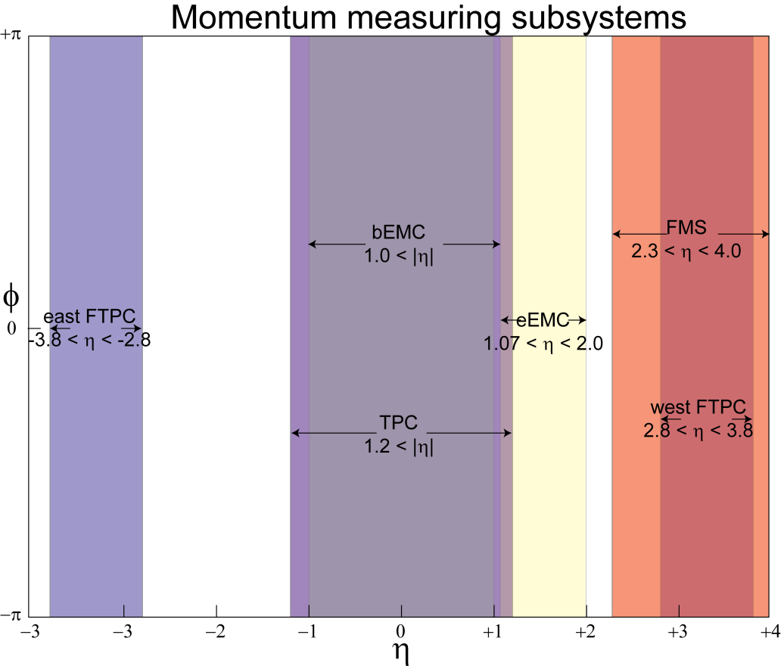
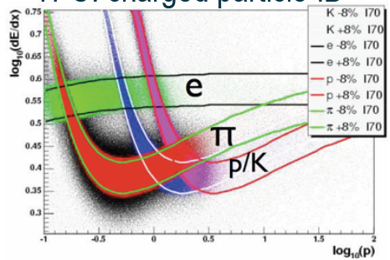
FMS
Central Region (-1<eta<1)
  Identified Pions, eta
  Jets
Endcap (1<eta<2)
  Pi0, eta, (some) jets
FMS (2<eta<4)
  Pi0, eta
Full azimuth spanned with nearly contiguous electromagnetic calorimetry from -1<η<4
⇒ approaching full acceptance detector
PID (Barrel) with dE/dx, in the future: ToF pi/K separation up to 1.9 GeV

Slide 6
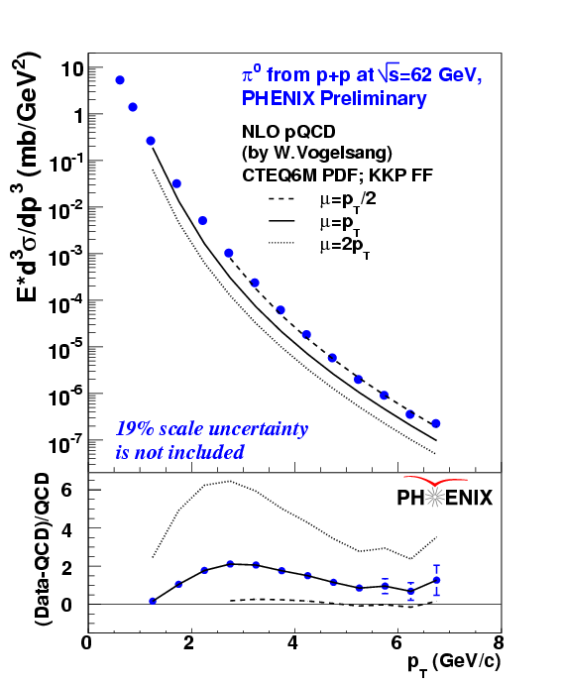
Cross sections @ √s=200 & 62 GeV
|η|<0.35
PHENIX pp→ π⁰ X
PRD76, 051106
PHENIX pp→γ X
PRL 98, 012002
PHENIX pp→ π⁰ X
62.4 GeV
|η|<0.35
Good agreement between NLO pQCD calculations and data
⇒ pQCD can be used to extract spin dependent pdf’s from RHIC data.

Slide 7
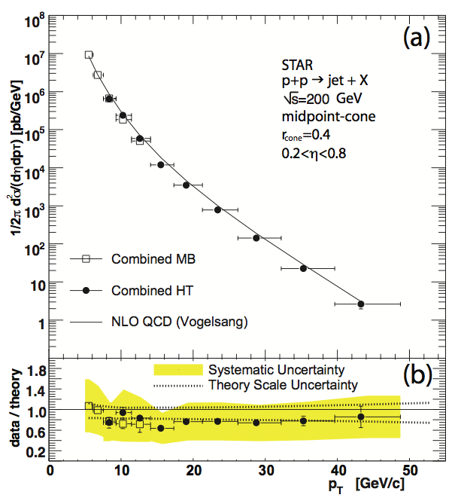
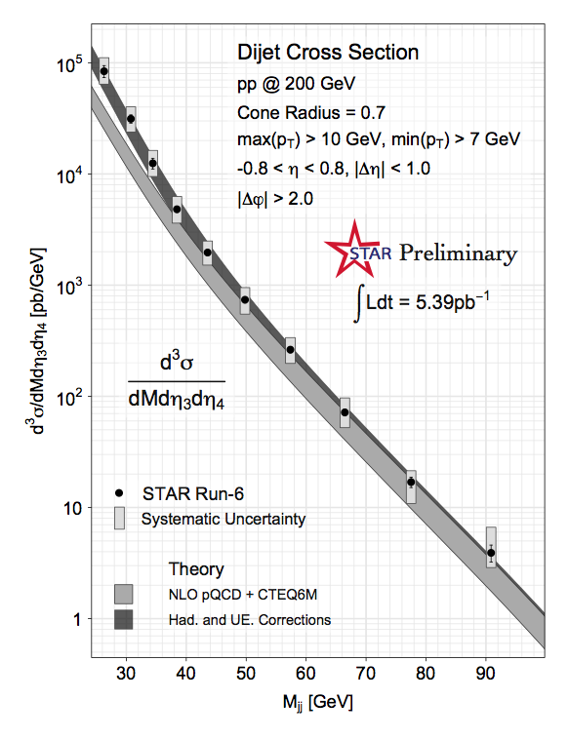
Jets: Proven Capabilities in p+p
B.I. Abelev et al. (STAR Coll.), Phys.Rev.Lett. 97, 252001, 2006
SPIN-2010: Matt Walker/Tai Sakuma, for the collaboration
Jets well understood in STAR, experimentally and theoretically

Slide 8
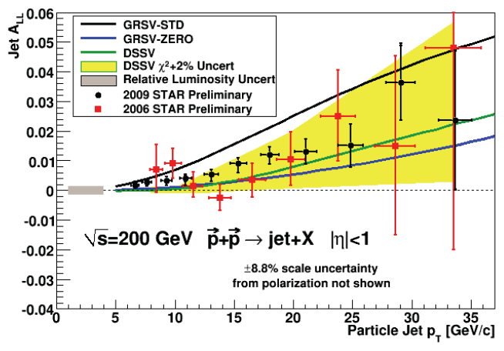
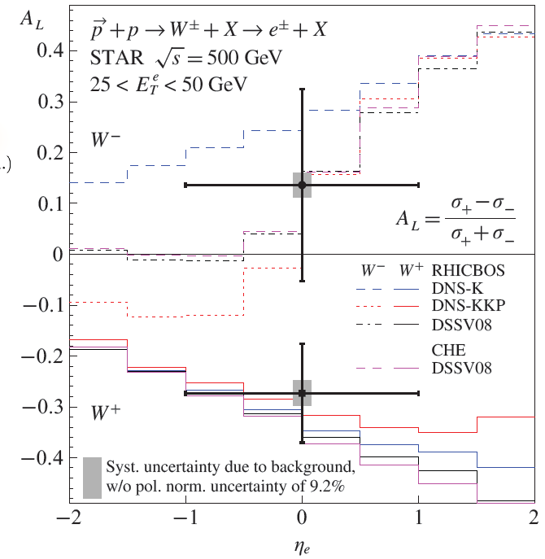
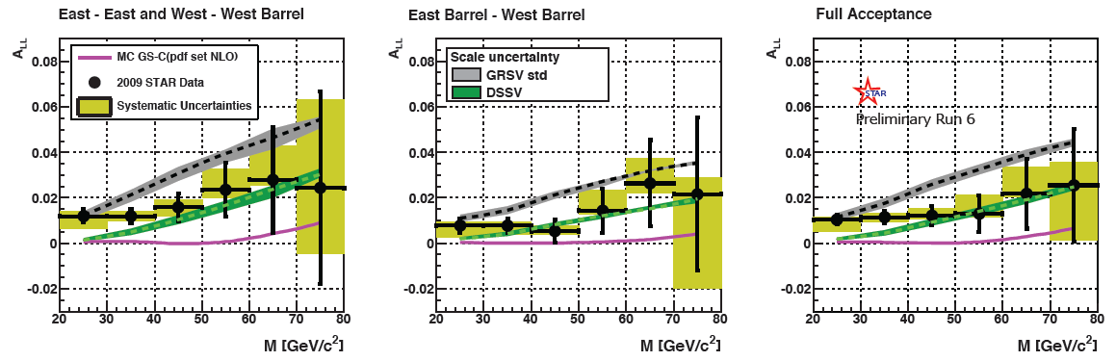
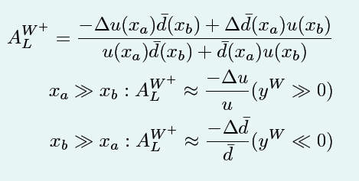
Highlights of Longitudinal Program: Measuring Delta G and Sea Helicities
Dijets

Slide 9
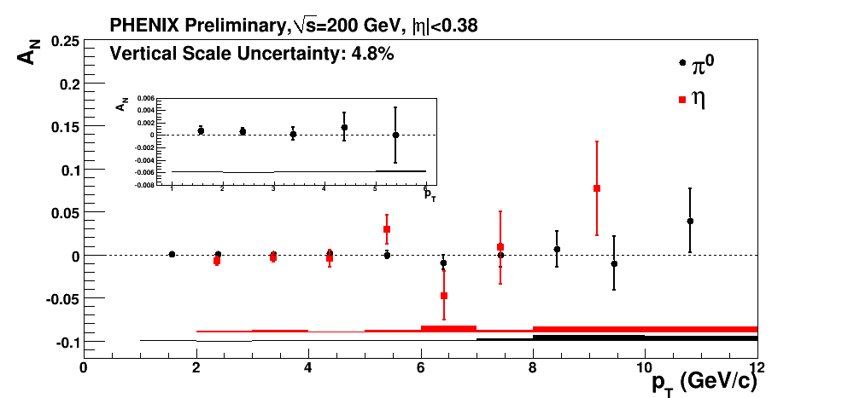
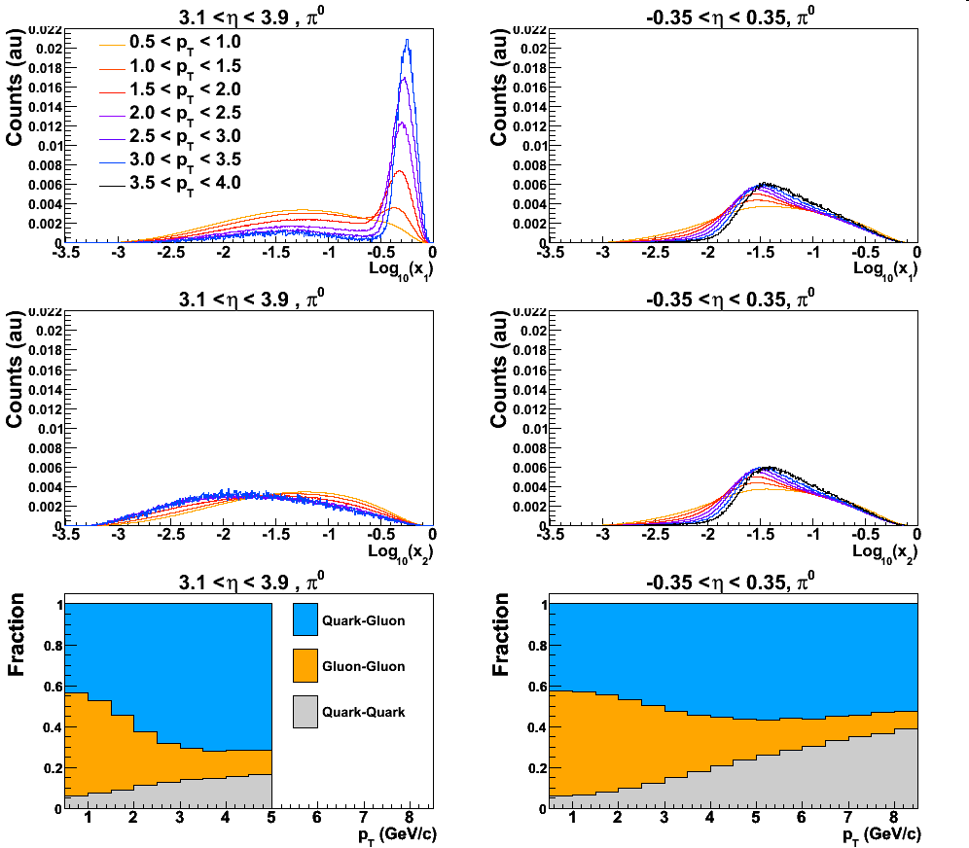
A_{N} Asymmetries at Midrapidity
π⁰ and η
√s=200 GeV
Left
Right
Little or no Asymmetries observed over a wide Pt range
Partonic Cross Sections
quark-gluon dominated in our pt range
gluon-gluon at low p_{T} (Sivers)
quark-quark at large p_{T} (Sivers+Collins)
Rules out a gluon Sivers??

Slide 10
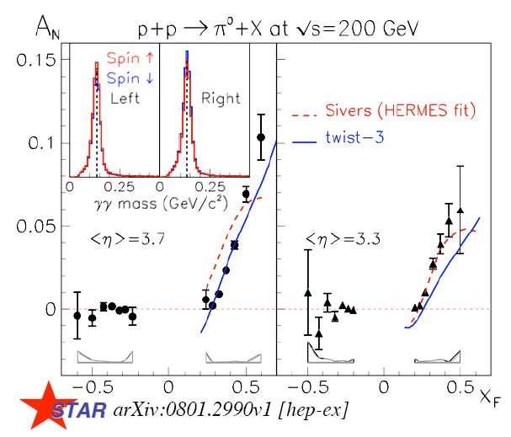
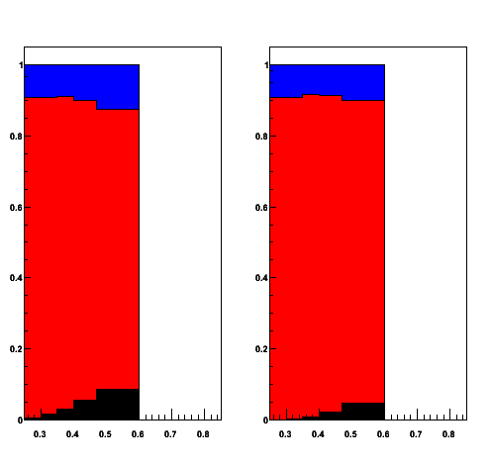
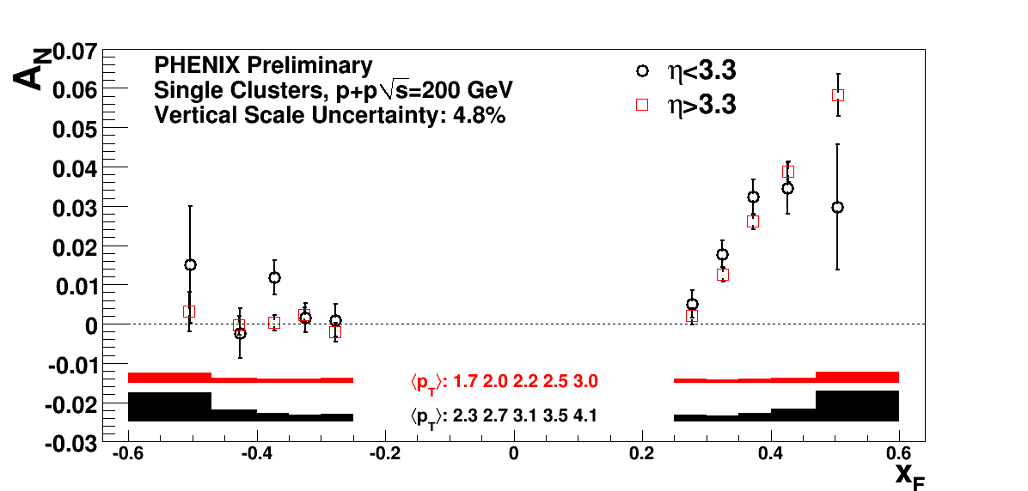
Going to A_{N} @ 200 GeV
Cluster Contributions
γ
π⁰
x_{F}
η>3.3

Slide 11
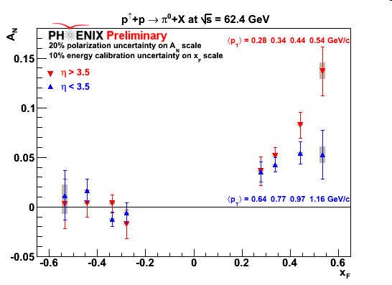
√s dependence
Asymmetries: forward region π⁰ 3.1 < | η | < 3.9, 62.4 GeV
No strong dependence on √s from 19.4 to 200 GeV
  Spread probably due to different acceptance in pseudorapidity and/or p_{T}
x_{F} ~ <z>P^{jet}/P_{L} ~ x : shape induced by shape of Collins/Sivers (weak evolution)
500 GeV soon

Slide 12
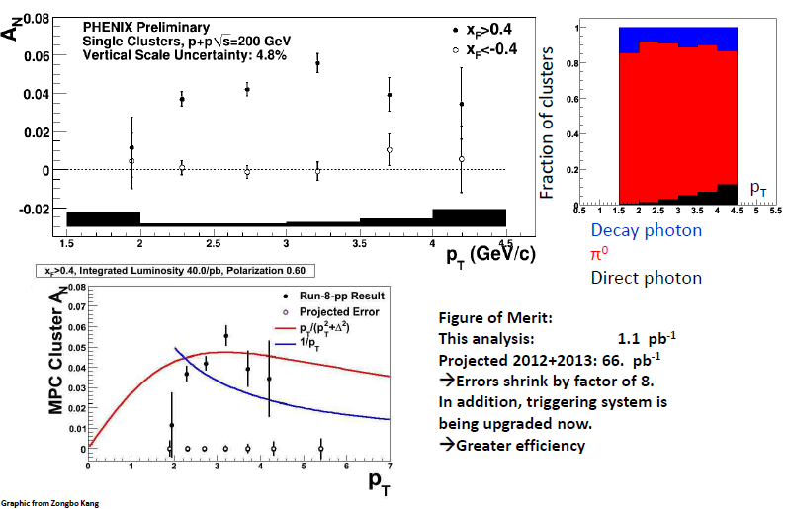
P_{T} Dependence
No evidence of 1/pt fall off yet w/ 8 pb-1 so far
Projected statistical errors are indicated from Run 12 &13
with expected 33 pb-1
From Run 13: A_N @ 500 GeV (Star FMS)

Slide 13
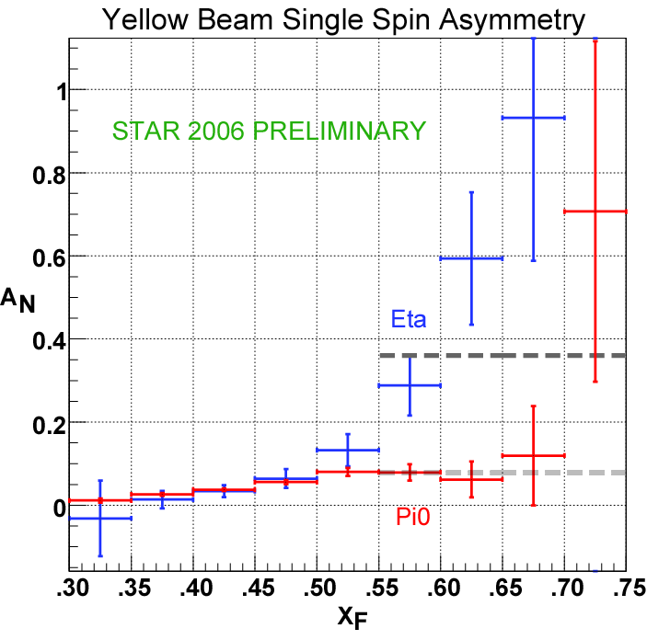
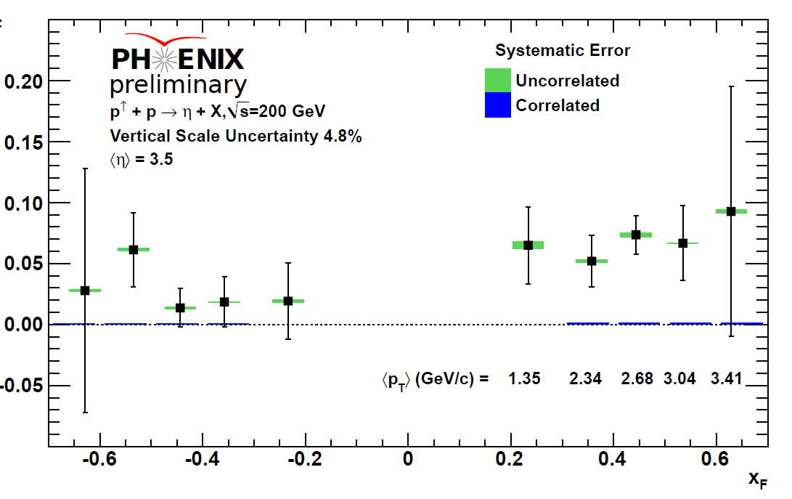
Asymmetries Forward Region: η @ 200 GeV
Significant asymmetries observed similar to pizero
Different fragmentation, strangeness, and isospin

Slide 14
Mid-Rapidity Collins Asymmetry Analysis at STAR
pbeam
STAR provides the full mid-rapidity jet reconstruction and charged pion identification
Look for spin dependent azimuthal distributions of charged pions inside the jets! First proposed by F. Yuan in Phys.Rev.Lett.100:032003.
Measure average weighted yield:
S⊥
ΦS
pπ
jT
Φh
–pbeam
PJET

Slide 15
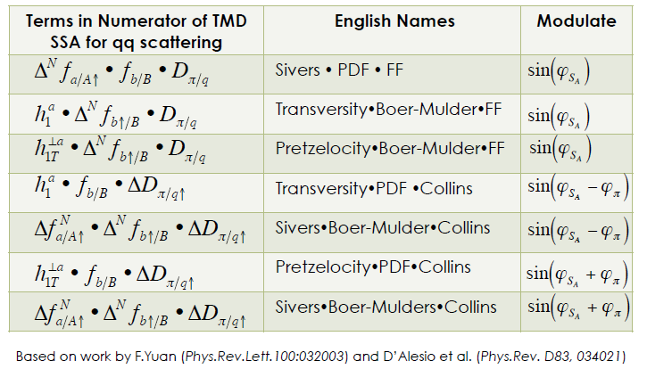
Moving on to Correlation Measurements: Pions in Jets
What about predictions, also for di-hadrons?

Slide 16
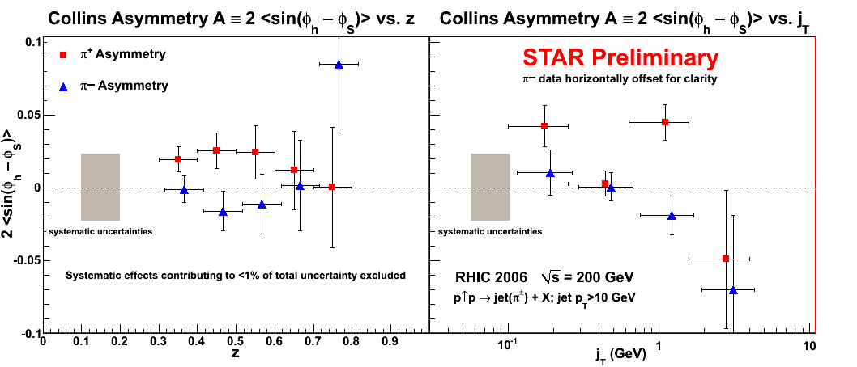
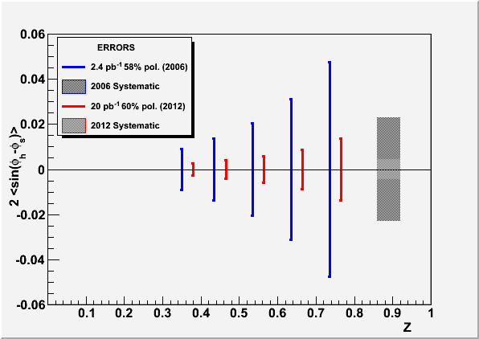
First Step: Mid-rapidity Collins analysis
Run 12 Projections

Slide 17
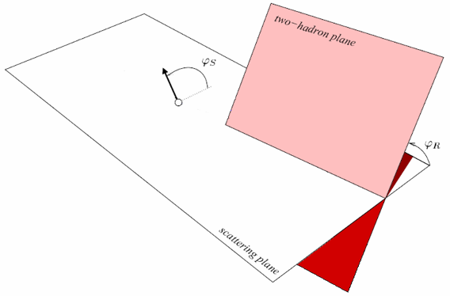
Di-Hadron Correlations
: Angle between polarisation vector and event plane
Bacchetta and Radici, PRD70, 094032 (2004)

Slide 18
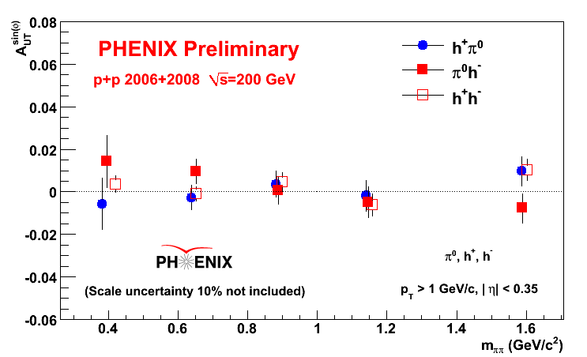
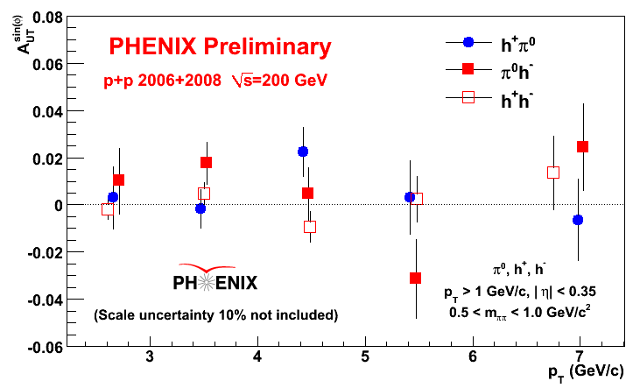
Correlation Measurements to Access Transversity (or other chiral odd function)
Phenix at Midrapidity: Small Asymmetries

Slide 19
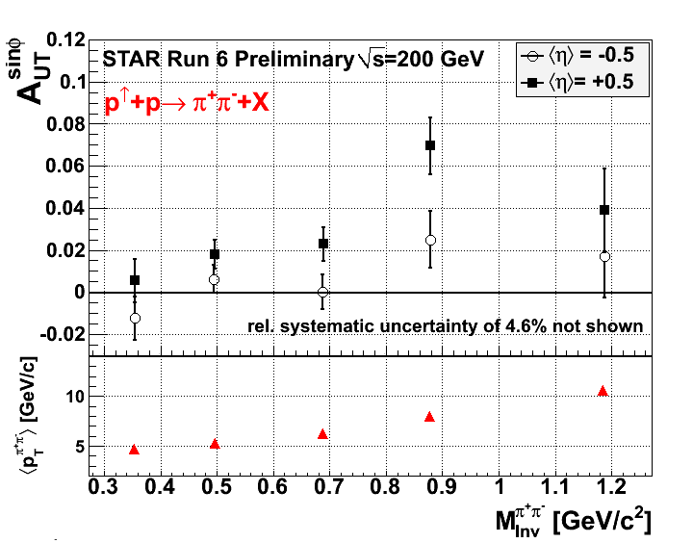
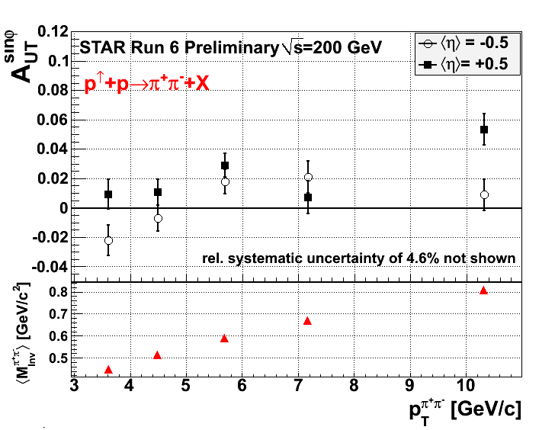
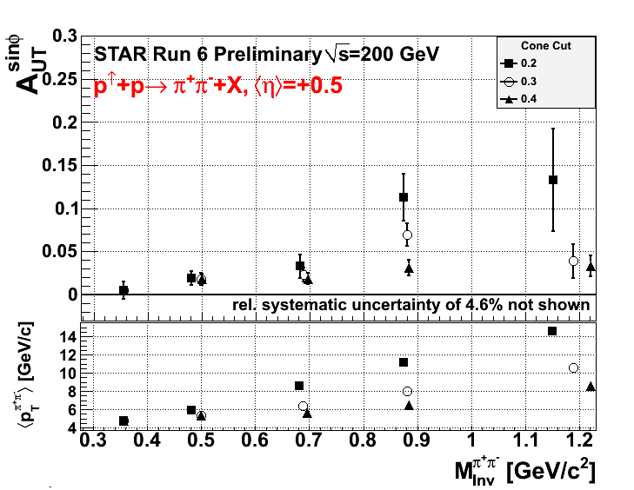
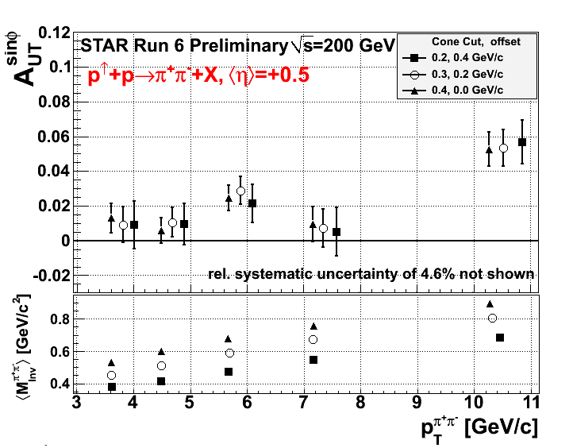
NEW: STAR shows significant Signal!

Slide 20
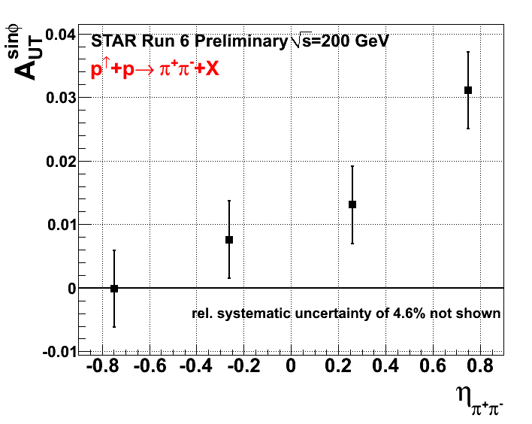
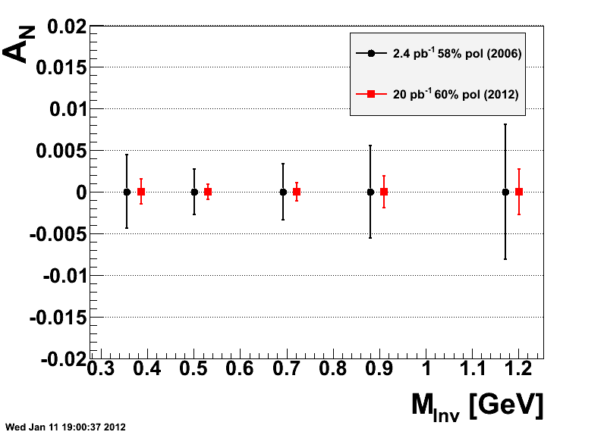
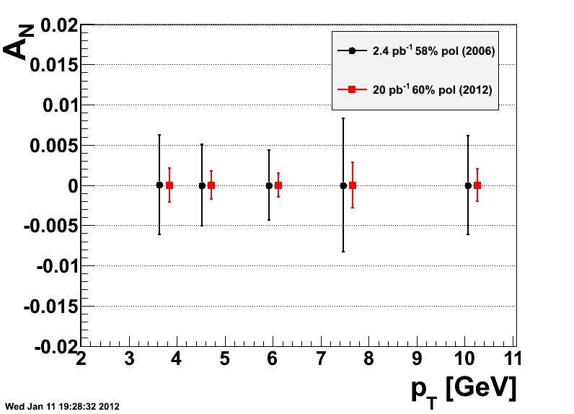
π⁺/π⁻
π⁺/π⁻
Additional precision data from this years run
+ increased kinematic reach

Slide 21
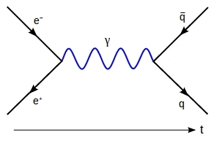
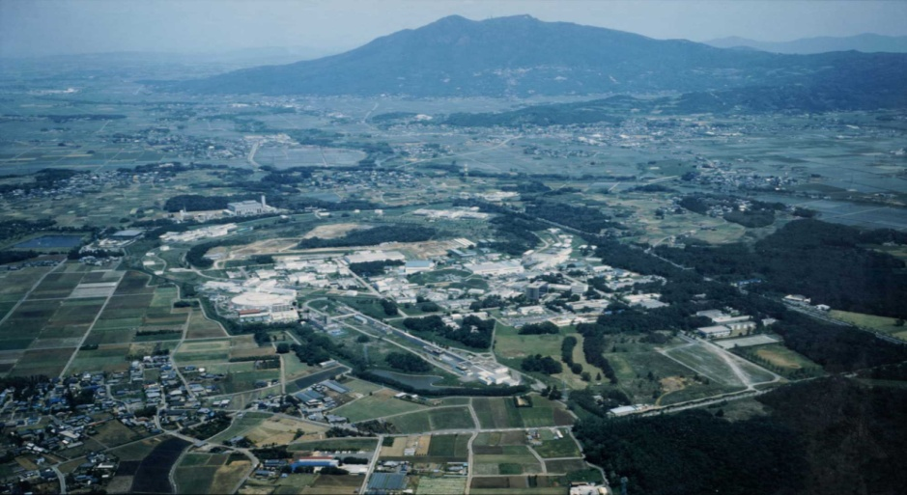
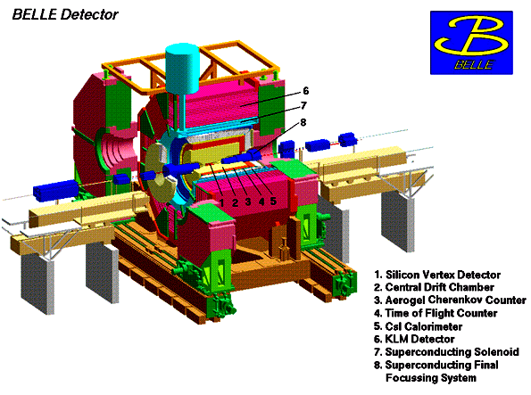
Measurements of Fragmentation Functions in e+e- at Belle
KEK-B: asymmetric e⁺ (3.5 GeV) e⁻ (8 GeV) collider:
-√s = 10.58 GeV, e⁺e⁻→Υ(4S)→B‾B
-√s = 10.52 GeV, e+e-→ qqbar (u,d,s,c) ‘continuum’
ideal detector for high precision measurements:
- tracking acceptance θ [17 °;150°]: Azimuthally symmetric
- particle identification (PID): dE/dx, Cherenkov, ToF, EMcal, MuID
Available data:
  ~1.8 *10⁹ events at 10.58 GeV,
  ~220 *10⁶ events at 10.52 GeV
Belle detector
KEKB
Notes:
Check number of events for continuum

Slide 22

Measuring transverse spin dependent di-Hadron Correlations
In unpolarized e⁺e⁻ Annihilation into Quarks
electron
Interference effect in e⁺e⁻
quark fragmentation
will lead to azimuthal
asymmetries in di-hadron
correlation measurements!
Experimental requirements:
Small asymmetries ➔
very large data sample!
Good particle ID to high
momenta.
Hermetic detector
ϕ₂
q₁
ϕ₁
z₂
q₂
z₁
quark-2
spin
quark-1
spin
z_{1,2} relative pion pair
momenta
positron
Notes:
22

Slide 23
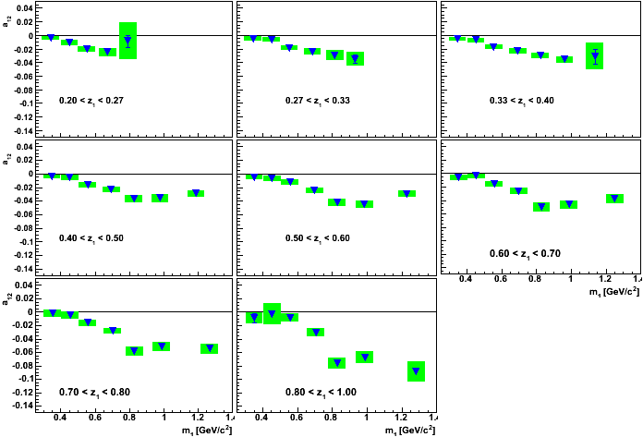
Results or IFF at (z₁x m₁) Binning
AV et. al, PRL 107, 072004(2011)

Slide 24
Spin-Averaged FF from Pion and Kaon Multiplicities
In LO: FF D_{i}^{h} describes probability for a parton i to fragment into a hadron h
FF at different energy scales relatable by DGLAP evolution equations
FFs D_{i}^{h} can be extracted from e+e- data in pQCD analysis:
e⁻
γ*
q
e⁺
q
Extraction from Experimental Data
h
measured:
hadron multiplicity
pQCD fit
extracted: FFs
Notes:
This is why we don’t really ‘measure’ unpolarized FFs but we measure sums of convolutions of coeff fcts with FFs
Start with:
with QCD analysis, FF can be extracted from hadron multiplicities
data come from different Q2, evolution allows us to simultaneously fit datasets from multiple Q2/experiments

Slide 25
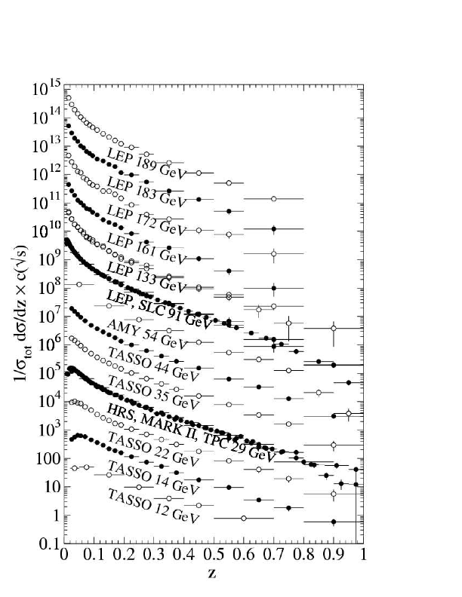
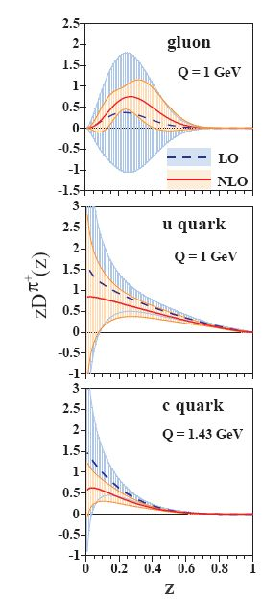

Extraction from Experimental Data
recent extractions of unpolarized FFs D_{i}^{h} propagating experimental uncertainties:
Improve knowledge of FF via
high precision hadron measurement at low Q²
'Global' Analyses (e⁺e⁻, SIDIS, pp):
de Florian, Sassot, Stratmann
Phys. Rev. D 75, 114010 (2007)
and
Phys. Rev. D 76, 074033 (2007)
First FF extraction including uncertainties (e⁺e⁻):
Hirai, Kumano, Nagai, Sudoh (KEK)
Phys. Rev. D 75, 094009 (2007)
large uncertainties (esp. gluon FF) due to:
- Lack of precise data at low energy scales (far from LEP)
- Lack of precise data at high z
D^{π+}_{i}

Slide 26
Systematic Corrections-Particle Misidentification/PID Calibration
Particle misidentification expected to be largest uncertainty:
particle identification probabilities p( i -> j ):
probability that particle of species i PID-selected as particle of species j.
p( π -> e )
Reconstructed particle
Belle PID likelihood information from:
Drift Chamber (dE/dx), Cherenkov, ToF, Calorimeter, Muon Detector
e
p( π -> µ )
Physical particle
µ
p( π -> π )
π
π
p( π -> K )
K
p( π -> p )
p
p( e -> e)
p( µ -> e)
p( π -> e )
p( K -> e )
p( p -> e )
p( e -> µ)
p( µ -> µ)
p( π -> µ )
p( K -> µ )
p( p -> µ )
[P]ij =
p( µ -> π)
p( π -> π )
p( K -> π )
p( p -> π )
p( e -> π)
p( e -> K)
p( µ -> K)
p( π -> K )
p( K -> K )
p( p -> K )
p( e -> p)
p( µ -> p)
p( π -> p )
p( K -> p )
p( p -> p )
~
^
^
~
correction through
inversion of matrix.
Nj = P Ni
Ni = P⁻¹ Nj :

Slide 27
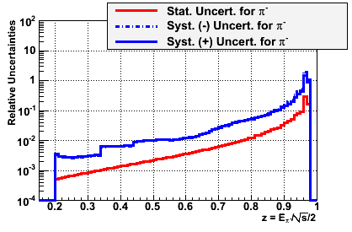
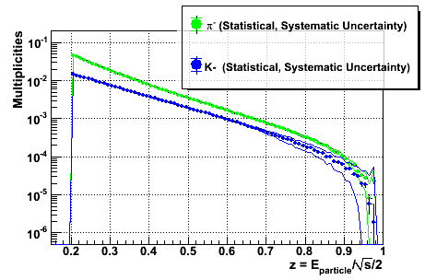
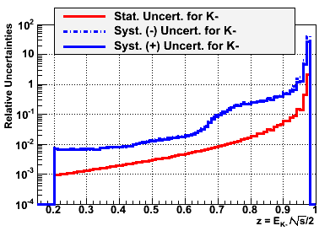
Pion and Kaon Multiplicities
Preliminary Results
Binning in z: width = 0.01; yields normalized to hadronic cross section
Systematic uncertainties: z ~0.6: 1% (2%) for π (K);
z ~0.9: 14% (50%) for π (K)
π⁻
Preliminary
Preliminary
Additional normalization uncertainty of 1.4% not shown.
K⁻
Preliminary
Belle experimental data, ~220M events
Notes:
Say charge resolved. Different charge: charge ratios off by 2 sigma from 1.0 for pi, within 1 sigma for K
Write: to be compared to slide 10

Slide 28
Summary and Outlook
RHIC collected data in polarized p+p from √s=62.4 GeV – √s=500 GeV
Non-zero signals for correlation measurements in the central region single TSA in forward region
Data taken this year will be able to probe p_{t} dependence of A_{N}, access transversity in di-hadron and Collins asymmetries
Belle measured
  unpolarized yield of pion and Kaons
  Transverse spin dependent single and di-hadron FFs

Slide 29
Backup

Slide 31
Extension of Di-Hadron correlations measurements at
Di-Hadron correlations measurements with current detector
  Need different charged hadrons
  π⁰ in Barrel and Endcap, π⁺ /π⁻ inTPC
Full azimuth spanned with nearly contiguous electromagnetic calorimetry from -1<η<4
⇒ approaching full acceptance detector
PID (Barrel) with dE/dx, in the future: ToF pi/K separation up to 1.9 GeV

Slide 32

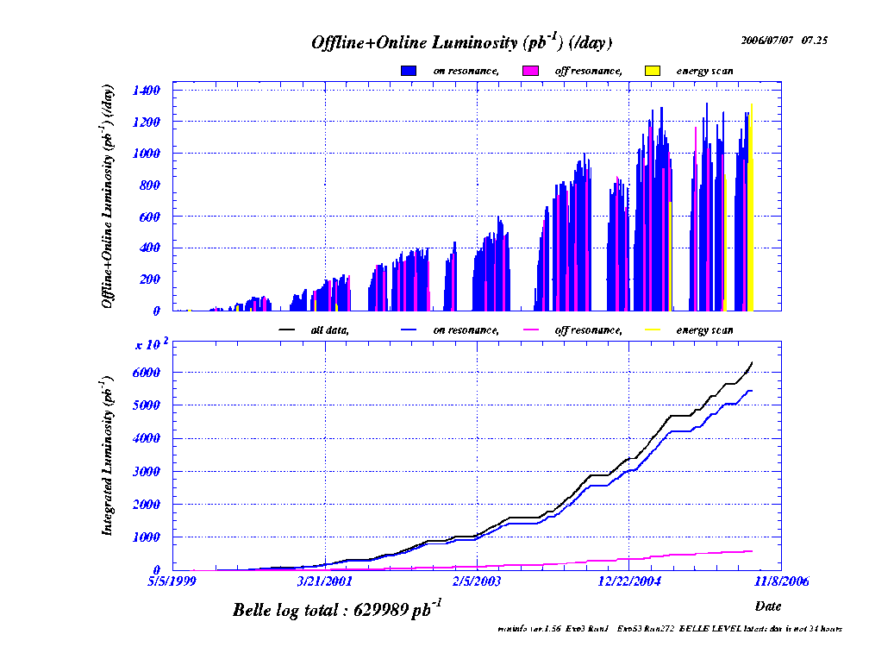
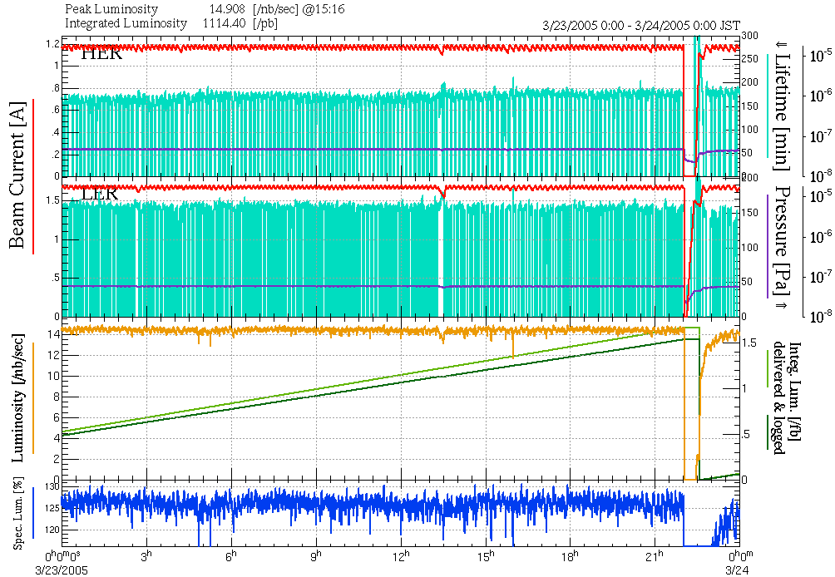
Measurement of Fragmentation Functions @
KEKB: L>2.11 x 10³⁴cm⁻²s⁻¹
Asymmetric collider:
8GeV e⁻ + 3.5 GeV e⁺
√s=10.58 GeV ((4S))
e⁺e⁻(4S)BB
Integrated Luminosity: > 1000 fb⁻¹
Continuum production: 10.52 GeV
e⁺e⁻(u, d, s, c)
>70 fb⁻¹ => continuum
Belle detector
KEKB
Anselm Vossen
32
32
Notes:
32
32

Slide 33
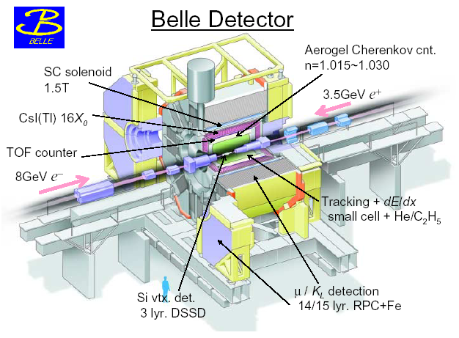
He/C2H6
Large acceptance, good tracking and particle identification!
Collins Asymmetries in Belle
33
33
Notes:
33
33

Slide 34
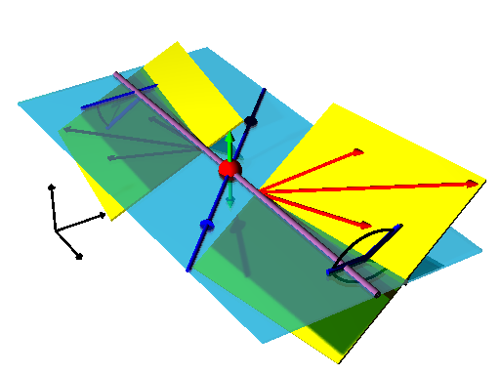
Interference Fragmentation–thrust method
ϕ₂−π
e⁺e⁻➔ (π⁺π⁻)_{jet1}(π⁻π⁺)_{jet2}X
Find pion pairs in opposite hemispheres
Theoretical guidance by papers of Boer,Jakob,Radici[PRD 67,(2003)] and Artru,Collins[ZPhysC69(1996)]
Early work by Collins, Heppelmann, Ladinsky [NPB420(1994)]
transverse spin projection
θ
π−ϕ₁
Model predictions by:
Jaffe et al. [PRL 80,(1998)]
Radici et al. [PRD 65, (2002)]
34
Notes:
34
→backup

Slide 35
Results or IFF at (z₁x m₁) Binning
A.V. et. al, PRL 107, 072004(2011)

Slide 36
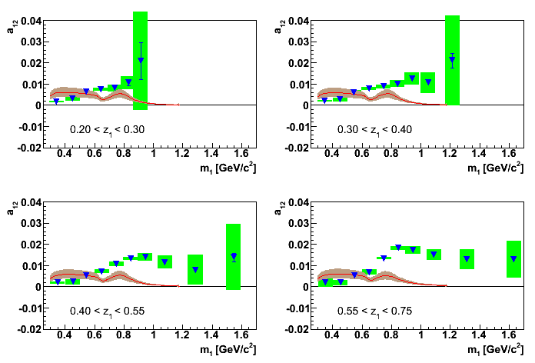

Comparison to Theory Predictions
Initial model description by Bacchetta,Checcopieri, Mukherjee, Radici : Phys.Rev.D79:034029,2009.
Leading order,
Mass dependence : Magnitude at low masses comparable, high masses significantly larger: More channels contribute (e.g. charm)
Z dependence : Rising behavior steeper

Slide 37


Hermes and Compass results on the proton
… look different still, but …

Slide 38


Upgrade to
Belle II is a significant upgrade to Belle and will sample 2 orders of magnitude higher luminosity
High precision data will enable measurement of
  P-odd FFs
  Transverse momentum dependent FFs
  Charm suppression possible
IU develops FEE for Barrel KLM detector crucial for high precision FF measurement of identified particles
Notes:
Deshalb Belle II, lumi etc…

Slide 39
4. Hadron FFs at Belle- Summary & Outlook
After Ia) first direct measurement of Collins FF,
Ib) first direct measurement of Interference FF: Significant asymmetries rising with invariant mass and fractional energy, for complementary extraction of quark transversity distributions.
II) Preliminary Result for Pion and Kaon Multiplicities for more precise spin-averaged FF- publication expected until September 2012.
Future high precision measurements of Hadron FFs at Belle:
- Kaon Collins FF
- Kaon Interference FF
- chiral-odd Λ FF
- k_{T} dependence of Collins and spin-averaged FF
- spin-averaged di-hadron FF

Slide 40



Investigation of tracking detectors is underway, Example FGT extension with smaller inner radius:
η=1.0
η=2.0
η
pbeam
S⊥
ΦS
Goal: Simulate expected physics signals from Jet asymmetries and modulations of hadron around jets
pπ
jT
Φh
–pbeam
PJET

Slide 41

Towards an eSTAR Concept - Electron Side
proton/nucleus
electron
ToF: π , K identification,
t0, electron
ECal: 5 GeV, 10 GeV, ...
electron beams
GCT: a compact low-mass
tracker with enhanced
electron capability;
seek to combine high-threshold
(gas) Cherenkov with TPC(-like)
tracking.
Simulations and R&D beginning;
- eSTAR task force formed,
- EIC generic R&D:
Hadron Calorimeter R&D proposal
Multi-institute LOI towards tracking R&D
ToF/ECal
TPC i.s.
GCT
TPC i.s.
ECal
Note: Hadron Side not shown here.

Slide 42




Next Step: Extend Tracking
Forward GEM Tracker (FGT) will provide tracking: go into forward region 1<η<2
Triple GEM Detector
Currently in commissioning
Will enable di-hadron measurements in the forward direction
Notes:
Before we go there, let’s remind us of the FGT

Slide 43

STAR forward instrumentation upgrade
proton
nucleus
~ 2016
~ 6 GEM disks
Tracking: 2.5 < η < 4
FMS
FHC
W powder E/HCal
Preshower
1/2” Pb radiator
Shower “max”
RICH
Baryon/meson separation
Forward instrumentation optimized for p+A and transverse spin physics
  Charged-particle tracking
  e/h and γ/π⁰ discrimination
  Baryon/meson separation

Slide 44



PHENIX Muon Piston Calorimeter Upgrade
SOUTH
Small cylindrical hole in Muon Magnet Piston, Radius 22.5 cm and Depth 43.1 cm

Slide 45

Measuring π⁰’s with the MPC
Clustering:
Groups towers together above an energy theshold
Fit energy and position of incident photon
If two photons are separated by ~1 tower, they are reconstructed as a single cluster.
Physics Impact:
Photon merging effects prevent two-photon π⁰ analysis:
for E_{pi0}>20 GeV (p_{T}>2 GeV/c)
At √s = 62 GeV
20 GeV → 0.65 x_{F}:Two-photon π⁰ analysis
At √s = 200 GeV
20 GeV → 0.20 x_{F} for two-photon pi0 analysis
Use merged Single clusters as proxy for pi0
Yields dominated by π⁰’s but subject to
backgrounds
Decay photon impact positions for low and high energy π⁰’s

Slide 46
STAR forward instrumentation upgrade
proton
nucleus
Central Region (-1<eta<1)
  Identified Pions, eta
  Jets
Endcap (1<eta<2)
  Pi0, eta, (some) jets
  Tracking (2012)
FMS (2<eta<4)
  π⁰, eta
FMS
TPC

Slide 47
Cluster analysis π⁰ measurement
Clustering:
Groups towers together above an energy threshold
Fit energy and position of incident photon
If two photons are separated by ~1 tower, they are reconstructed as a single cluster.
Physics Impact:
Photon merging effects prevent two-photon π⁰ analysis:
for E_{pi0}>20 GeV (p_{T}>2 GeV/c)
At √s = 62 GeV
20 GeV → 0.65 x_{F}:Two-photon π⁰ analysis
At √s = 200 GeV
20 GeV → 0.20 x_{F} for two-photon pi0 analysis
Use merged Single clusters as proxy for pi0
Yields dominated by π⁰’s but subject to
backgrounds
Decay photon impact positions for low and high energy π⁰’s
47

Slide 48

Star Detector is well suited for Jet and Correlation Measurements

Slide 49


Slide 50


Slide 51






Isospin Dependence
√s = 62.4 GeV
fragmentation u/d
1:0
2:1
1:1
u
u
Transversity
Sivers
A_{N}(π⁰) ~ 2A_{N}(π⁺) + A_{N}(π⁻) ?
d
d

Slide 52






Spin Physics at RHIC
Left
←Central, Forward→
Right
A_{N} difference in cross-section between particles produced to the left and right
E704: Left-right
asymmetries
A_{N} for pions:
π⁺
π⁰
Partonic fractions in jet production at 200 GeV
π⁻
x_{F}
10
20
30 pT(GeV)
0
52
Notes:
For most RHIC kinematics, gg and qg dominate, making A_{LL} for inclusive jets sensitive to gluon polarization.
a_{LL} is partonic asymmetry calculable in pQCD

Slide 53

STAR A_{LL} from 2006 to 2009
2009 STAR A_{LL} measurements:
Results fall between predictions from DSSV and GRSV-STD
Precision sufficient to merit finer binning in pseudorapidity

Slide 54
Asymmetries: forward region π⁰ clusters
Cluster contribution
decay photon
π⁰
direct photon
Estimated using Pythia
η<3.3 η>3.3
x_{F}
x_{F}

Slide 55

Interference Fragmentation Function in p-p
φ_{R}-φ_{S}
X
c
a
b
X
$$A_{UT}∝h_{1}∙H_{1}^{<}$$
φ_{S}
: Angle between polarisation vector and event plane

Slide 56


II) Pion and Kaon Multiplicities
3) Systematic Corrections- Particle Misidentification/ PID Calibration
Experimental data based extraction of PID probabilities by decay sample study
K⁻
a) Kinematically reconstruct D*
b) extract PID probability from invariant mass plots
e.g. D*
D⁰
π⁺_{slow}
π⁺_{fast}
m_{D*} -m_{D°} for K⁻ tracks with
p_{lab} in [1.4; 1.6] GeV/c,
cosθ_{lab} in [0.02; 0.21],
reconstructed as π
p( K⁻ -> π ⁻ )
-------------
=
m_{D*} -m_{D°} for K⁻ tracks with
p_{lab} in [1.4; 1.6] GeV/c,
cosθ_{lab} in [0.02; 0.21]
p( K⁻ -> π⁻ ) ≈ 0.111 ± 0.004

Slide 57




II) Pion and Kaon Multiplicities
3) Systematic Corrections- Particle Misidentification/ PID Calibration
sample PID probabilities from D* decay studies
completed extensive data-based PID calibration by extraction of probabilities
p(π, K -> j ) from D* decay sample,
p(π, p -> j ) from Λ decay sample,
p(e, µ -> j ) from J/ψ decay sample.
Notes:
- Vertical lines indicate bin boundaries
- Structure in kinematic dependence of probabilities bc PID likelihood information combination of all PID subdetectors & subdetectors have different efficiencies in different kinematic areas

Slide 58


II) Pion and Kaon Multiplicities
3) Systematic Corrections- Impurities in Measurement Sample
_
For same luminosity, compare qq, τ τ, 2γ Monte Carlo samples
generated by resp. cross sections after analysis cuts
At high z, main impurities for pions from τ events: up to 35%.
Plots from about 430 * 10⁶ Monte Carlo Events.
π⁻
qqbarMC
_
Yields from qq events relative to total yields for π⁻, K⁻
Absolute yields from different
event types for π⁻
Notes:
Explain shown Monte Carlo: generated according to cross sections

Slide 59


II) Pion and Kaon Multiplicities
3) Systematic Corrections- Other Corrections
Monte Carlo-based correction for kinematical smearing.
Further corrections:
- Decay-in-flight,
- Detector Interaction/ shower particles,
- Detector/tracking efficiencies,
- Analysis acceptance,
- Initial State Radiation (ISR).
z_reconstructed
z_physical
10⁹ Monte Carlo events after analysis cuts

Slide 60


Ib) Interference FF at Belle
Transversity Distribution Extraction
A. Bacchetta, A. Courtoy, M. Radici
Phys.Rev.Lett. 107, 012001 (2011)
A. Courtoy, Thu 11.40
Transversity from Collins Analysis
Transversity from Belle (IFF*IFF) &
HERMES data (Transversity*IFF)
Notes:
-Compare transveristy extraction to lattice claclulations
-additional dof from detecting second hadron-> quark spin sensitivity survives kt integration
(=> should see sin2theta/(1+costheta) dependence in asymmetries, sin2theta from sz=0 virt photon state, the 1/(1+costheta)
from the other two hel states sz = +-1)
=> collinear models for factorization usable & for QCD evolution, not involving tmd convolutions or moments (vs CollinsFF)
-again vs cancellation in unpolarized e+e-: measuring correlations of hadrons in opposing hemisphere
-> correlation doesn’t vanish bc qqbar pair has correlated spins
-IFF describes fragmentation of q w transverse spin into pair of unpol hadrons
since quark spin not known in e+e- -> not measure angle between quark spin and zimuthal angle of plane spanned by two hadrons
wrt to transverse quark spin. But measure correlation of angles phi1 pih2 of 2 pairs in opposing hemispheres wrt plane spanned
by e+e- axis & thrust/qqbar axis.
- Can’t measure IFF as a whole -> partial wave analysis, expand in Legendre polys, first two terms enough to get minimal set for description
of all polarization states of system in cm frame for relative partial waves l=0,1 (s and p) & unpolarized contrib.
low invariant mass hadron pairs are mainly produced in s and pwave channel. P wave contribution viewable as fragmentation of spin1
parts (the rho for pi pair production)- so pi pairs actually supposed to come from a real rho in both hemispheres?
- IFF should show strong dependence on inv mass of hadron pair bc relative partial waves of pi and k pairs determined by resonance they were produced from, so upper point is correct…
- predictions from Collins & Ladinsky; Jaffe, Jin, Tnag; Radici, Jakob, Bianconi; Bacchetta and Radiciexist predictions for asymmetries at belle obtained from fit to hermes data and evolution to belle scale

Slide 61
Physics measured at Belle
Precision measurements of formation of hadrons
from quarks/anti-quarks resulting from the
annihilation of electron-positron pairs colliding at high energy.
Application
  Measurement of spin-dependent Collins- and Interference- FFs at Belle:
  enable extraction of quark transversity distributions
  from pp at RHIC; SIDIS at HERMES, Jlab and COMPASS
  Precise information on spin-averaged pion and kaon FFs, in particular
  at high normalized hadron energy z: improve the precision of ΔG
  from QCD analysis of polarized pp data from RHIC

Slide 62
Spin Dependent FF in e⁺e⁻ : Need
Correlation between Hemispheres !
Asymmetry is
  Need fragmentation function
Quark spin direction unknown: measurement of
Interference Fragmentation function in one hemisphere is not possible
sin φ modulation will average out.
Correlation between two hemispheres with
sin φ_{Ri} single spin asymmetries results in
cos(φ_{R1}+φ_{R2}) modulation of the observed di-hadron
yield.
Measurement of azimuthal correlations for di-pion pairs
around the jet axis in two-jet events!
Notes:
Show formula from before
62

